Slide 1
Student Classroom Engagement Student Performance
Analysis Project
PRESENTING DATA ON
ANALYZING HOW THESE DATA IMPACTS HIGHER EDUCATION
Spreadsheets, tableau, R studio, kaggle.com, PowerBI
Kazi Rafsun

Slide 2
Problem Statement: Present Education Data from Current Trends
Goals/metrics: How these data impacts higher education

Slide 3
Approach
First Data set: I look at the global map and see how much proportion of students are engaging in classroom discussion and their country of origin
Second data set: I look at Gender Difference in my population sample
Racial Difference
Score analysis on all students
How the Racial group difference give insights to the score analysis of all students
Correlation between All students Subject scores (Reading, Writing, and Math)

Slide 4
Data Sets:

Slide 5
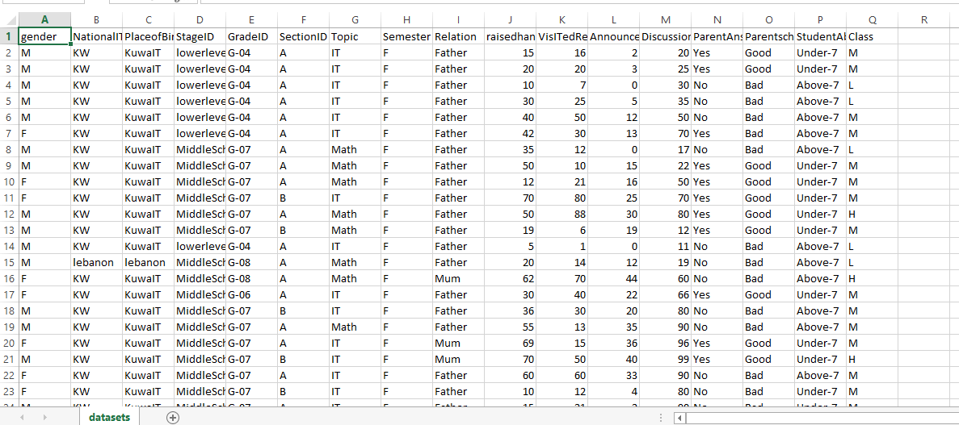
Student Discussion Engagements Raw Data Across the Globe from All over the Place

Slide 6
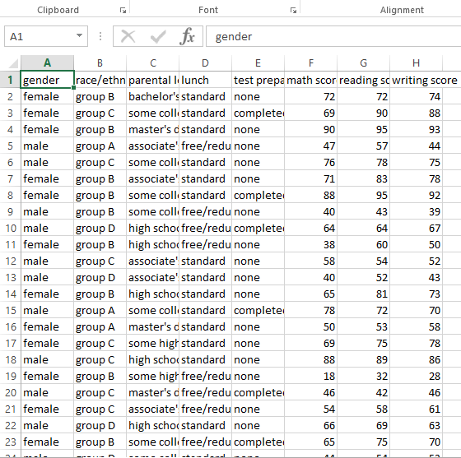
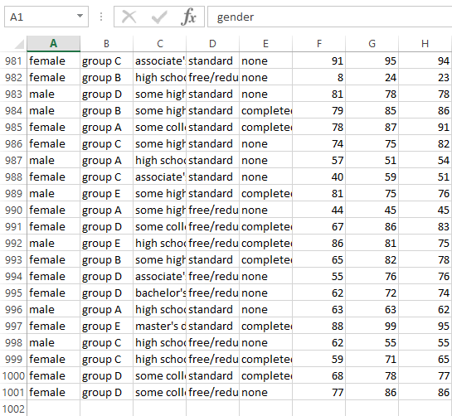
Student Ethnicity and Test Score Raw Data
Data Cleaning steps: I ran SQL queries to check for duplicate data entries. If duplicates exist it can skew my results is why cleaning is so important to start with

Slide 7
Analyzing Students Attendance origin and Classroom participation

Slide 8
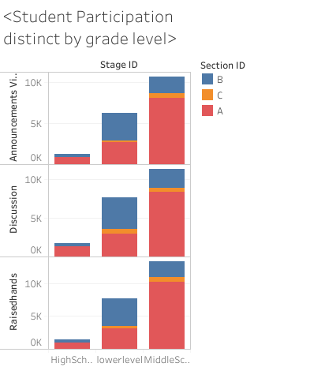

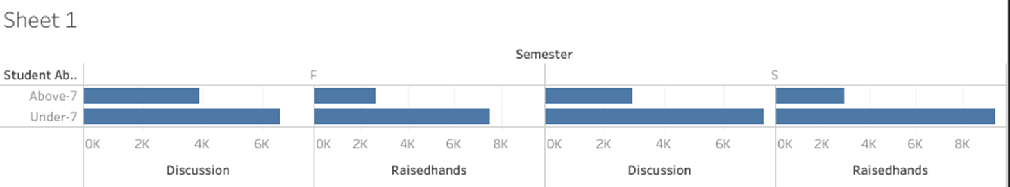

Slide 9
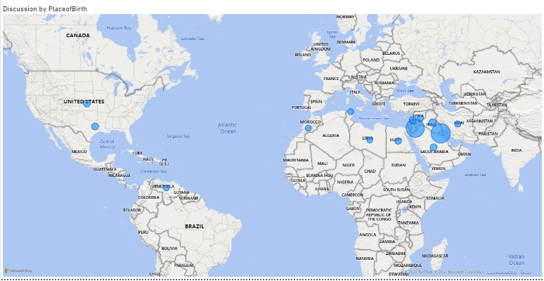
Participation in Classroom Discussion Varies with Student’s Nationality
FINDINGS
Students Originated from Saudi Arabia have increase class discussion participation

Slide 10
Analyzing Gender Gaps and Racial Differences

Slide 11
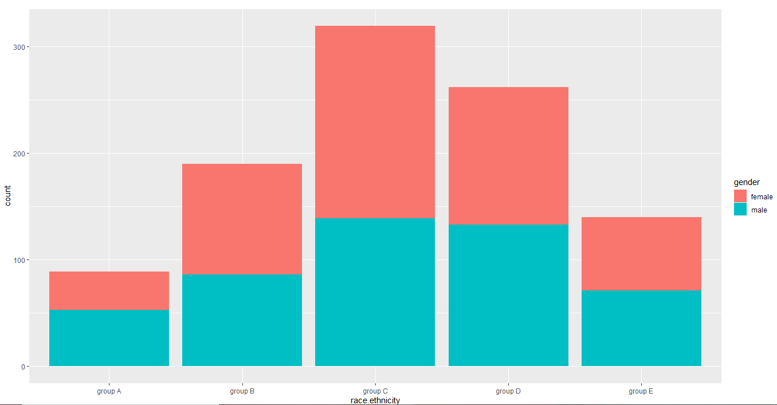
Analyzing gender difference Across Various Racial Groups
ANALYSIS
> ggplot(data=mydata)+geom_bar(mapping = aes(x=race.ethnicity,fill=gender))
Blue proportion is for the male gender and the pink portion is for the female gender

Slide 12
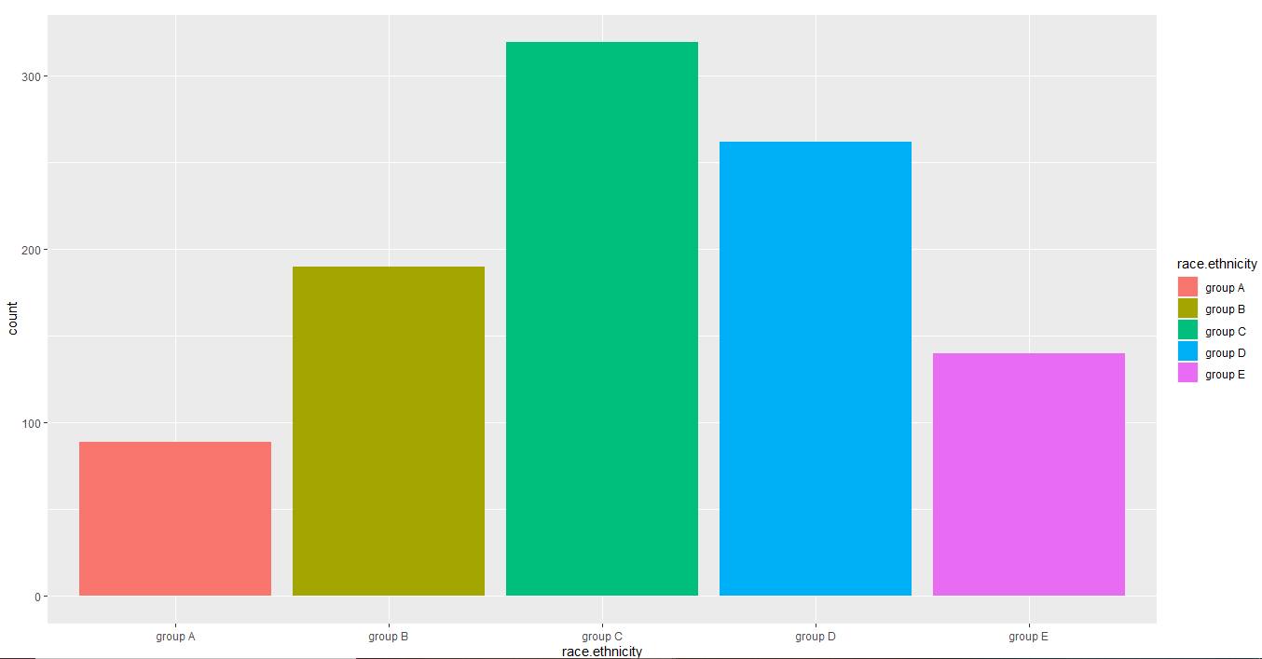
In this data set which group contain the highest number of students?
ANALYSIS
Analyze, draw plots, and Visualize data sets using R programming
>ggplot(data=mydata)+geom_bar(mapping = aes(x=race.ethnicity))
Breaking down the ethnic groups and looking at gender proportions

Slide 13
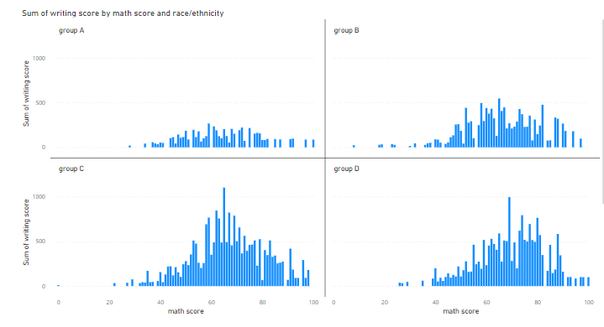

Score Variation By Racial Groups
Group C & D show high variation in scores

Slide 14
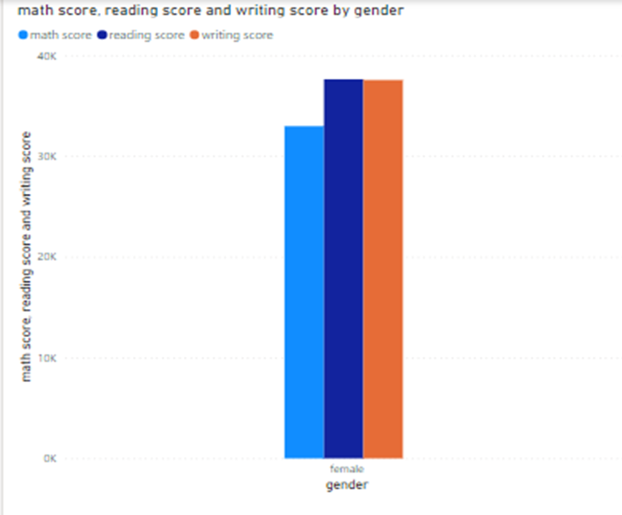
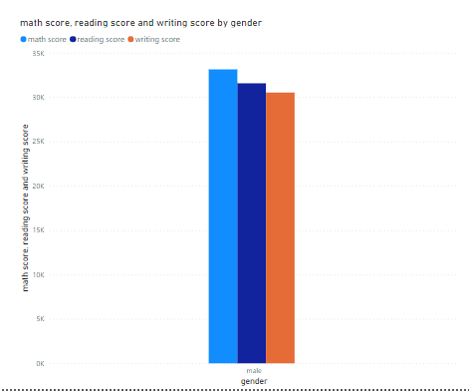



Gender Difference and Score variation
Male Students prioritize Acquiring higher Math scores
>ggplot(data=mydata,aes(x=reading.score,y=writing.score))+geom_point(aes(color=race.ethnicity))+facet_grid(gender~race.ethnicity)
M A T H

Slide 15
Individual Score Analysis Test Preparation Analysis

Slide 16
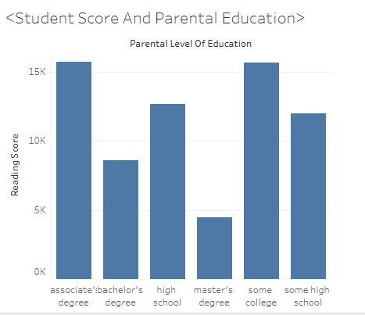
Reading Score Analysis: Parents with Upper level Education have kids who perform poor in tests

Slide 17
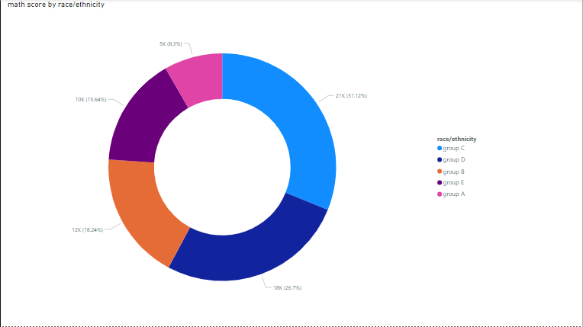
Math Score Analysis: Analysis on ALL Students counting Gender difference and Racial difference
FINDINGS
Group E Acquire Higher Math Scores

Slide 18
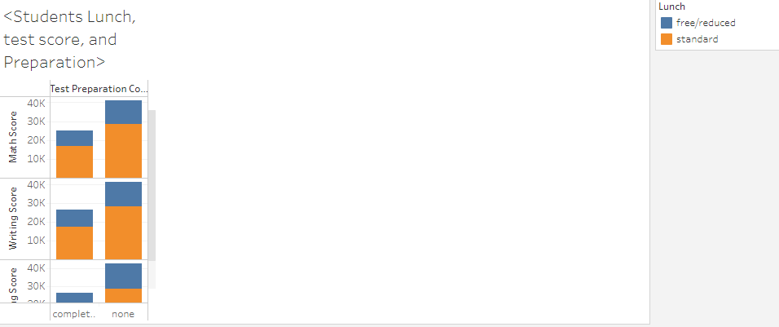
Test Preparation Analysis: Students Lunch, test scores, and Test Preparation

Slide 19
Score Trends Across Students in Scatterplots

Slide 20
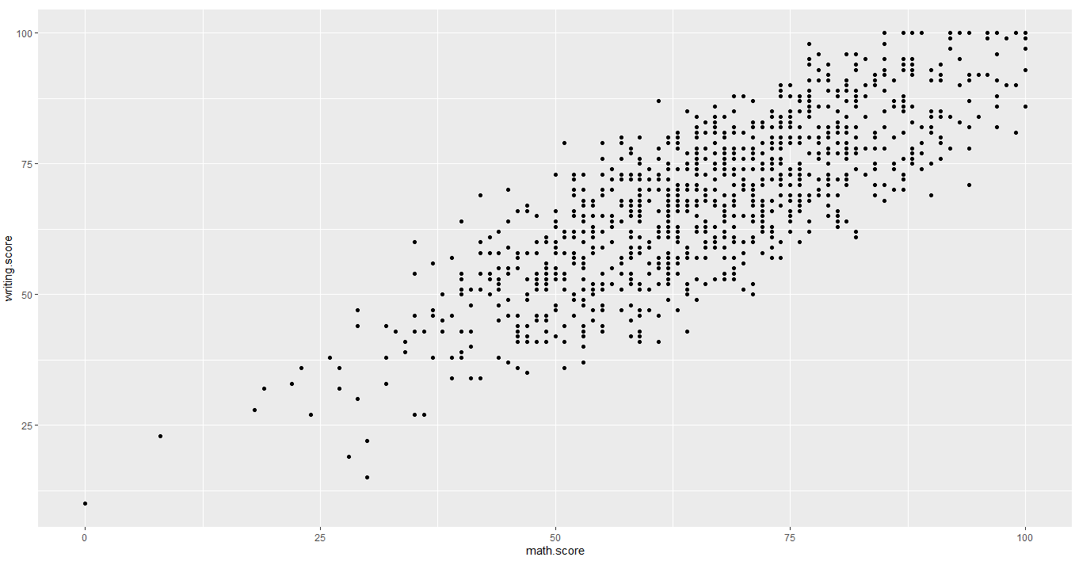
Relation between subject scores in R visualization analysis
FINDINGS
Students who achieve higher math score also achieve higher writing score
> view(mydata)
>ggplot(data=mydata)+geom_point(mapping = aes(x=math.score,y=writing.score))

Slide 21
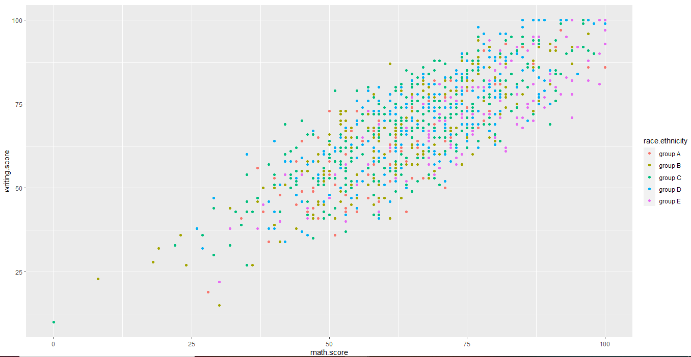
Relationships in scores varies between the variable race/ethnicity
Individual dots are representative of various groups and their scores

Slide 22
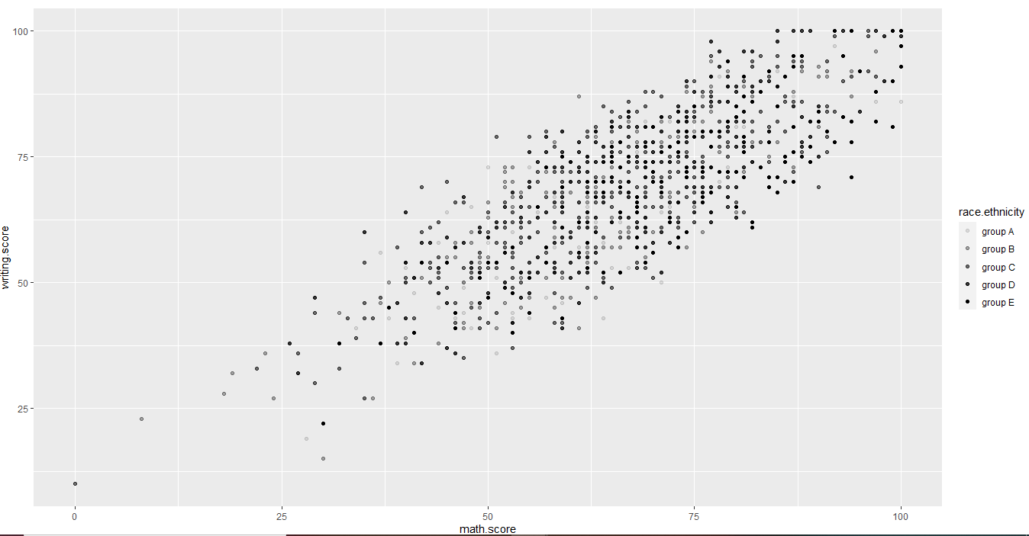
Racial group D and E pops up in this dataset to tell us that these groups achieve higher score
FINDINGS

Slide 23
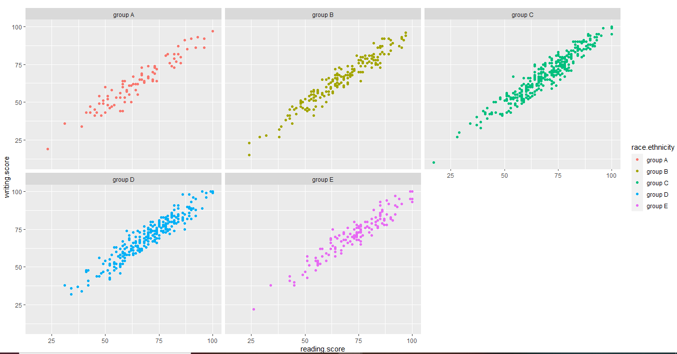
Positive correlation in English subject scores across race/ethnicity groups
FINDINGS
>ggplot(data=mydata,aes(x=reading.score,y=writing.score))+geom_point(aes(color=race.ethnicity))+facet_wrap(~race.ethnicity)

Slide 24

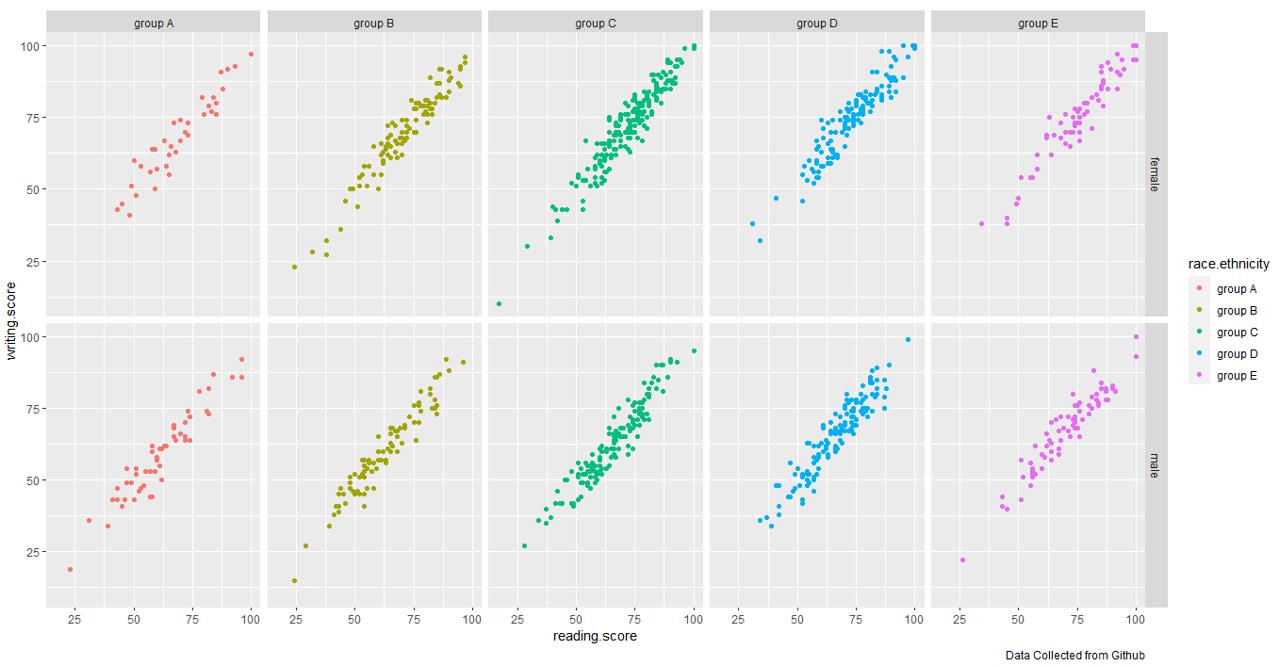
Both gender draws similar correlation trends

Slide 25
After Analyzing these data promoting higher education is a top priority
Future Implementation
Tutoring in English and Math
Olympiad, drama, story telling, writing contest, student newspaper
Increase participation/classroom attendance
Equal opportunity for students

Slide 26
Thank you ALL

